Slide 1
The Data Talks Back
Speech & Language AI For The Data Professional
Matt Gordon
Dir. Of Data and Infrastructure
Rev.io

Slide 2


About Me
20+ years of SQL Server experience
Microsoft Data Platform MVP
Friend of Redgate
Managed 24x7 datacenters
Worked on development teams
International data community speaker
Leader of Lexington, KY (USA) Data Technology Group
sqlatspeed everywhere online

Slide 3
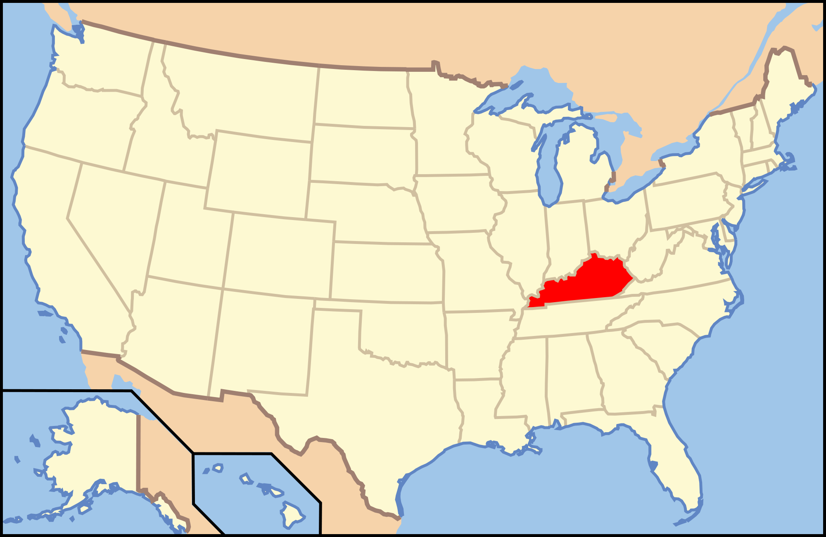
About Me – Where I’m From

Slide 4

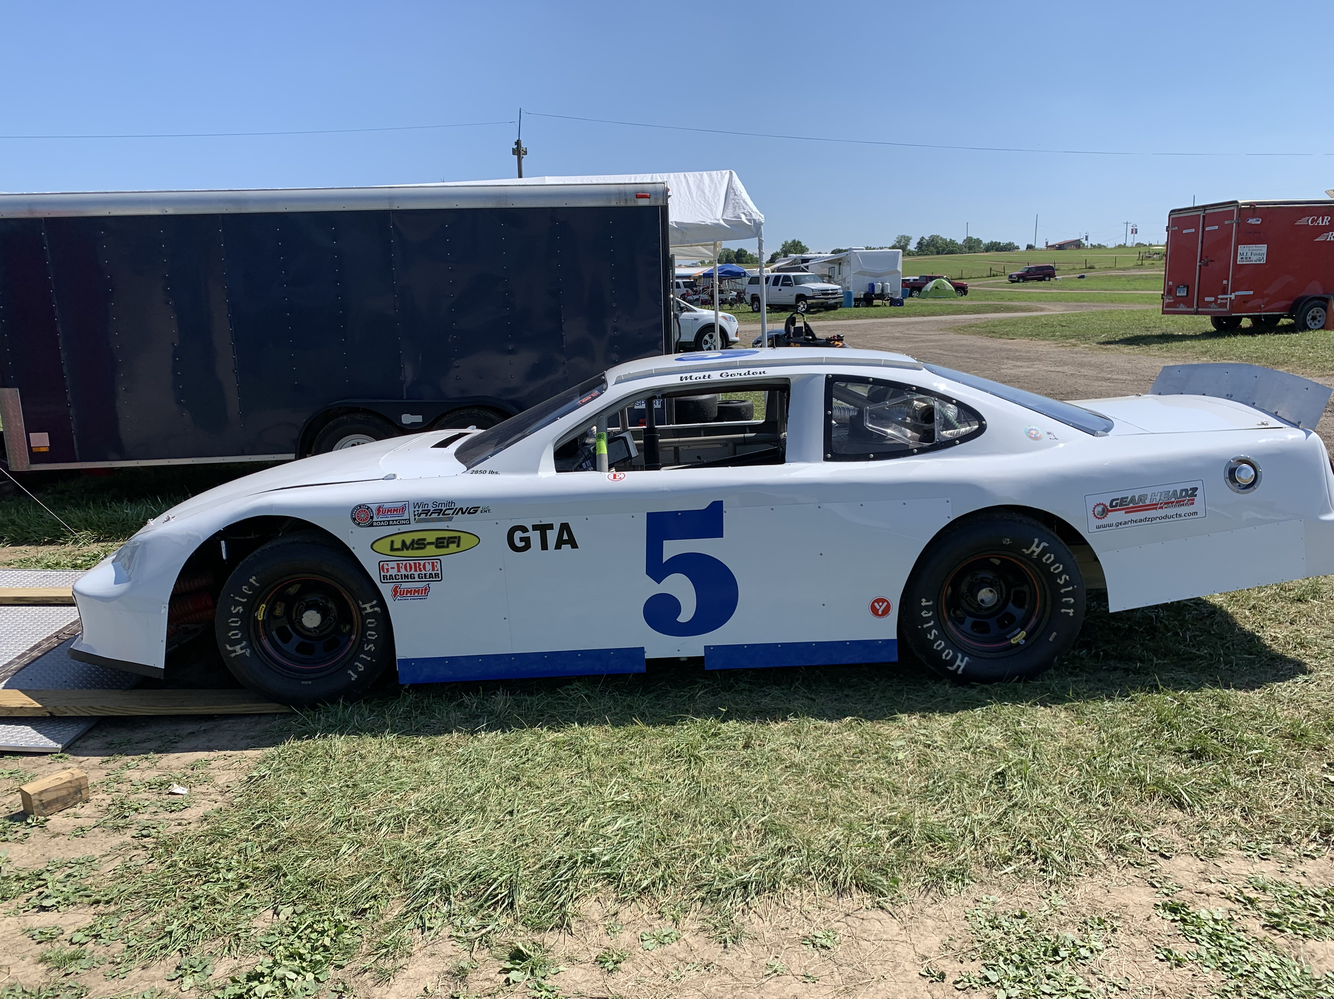

How I Picked My Twitter Handle and Domain Name

Slide 5
What are speech AND LANGUAGE ai?
Introducing Azure Cognitive Services

Slide 6
What is Azure Cognitive Services?
Set of APIs
“Sets of machine learning algorithms to solve problems in the field of AI”
Code you can call with code or bots of your own
How do I use them?
Can be consumed via standard REST calls
No code interaction (Logic Apps, QnA Maker, etc.)
How do I learn to call them?
Great Microsoft documentation found here: https://bit.ly/2sxsqry

Slide 7
What is Azure Cognitive Services?
List of Cognitive Services APIs
Vision (analyze images and videos)
Speech (speech recognition and speaker identification)
Language (understand sentences and intent)
Decision (Anomaly Detector, Content Moderator, etc.)
Speech and Language
Speech or text are the foundations of communication
APIs can be combined
Majority of communication is done “under the covers” via JSON

Slide 8
What IS THE LANGUAGE API?

Slide 9
What Is The Language API?
What does Microsoft say?
It “increases your application’s ability to read, comprehend, and enrich written text”
What do I say?
It helps us and our applications communicate with users, customers, and potential users/customers
Is it just one API?
Absolutely not
Contains a number of APIs

Slide 10
What Is The Language API?
What can I do with it?
Immersive Reader
Language Understanding (LUIS)
QnA Maker
Text Analytics
Translator Text

Slide 11
What Is The Language API?
What can I do with Immersive Reader?
Helps “emerging readers, language learners, and people with learning differences” absorb the written content on your site or in your application
Can change the viewable size of the text
Can display “tool tip” pictures of commonly used words
Can highlight the nouns, verbs, etc. in a sentence
Can read the content out loud
Can display the syllables of words
Uses Translator API to translate the content into another language
Notes:
Adds to the inclusivity of online presence and user experience
Excellent tutorial in Microsoft docs for those interested

Slide 12
What Is The Language API?
What can I do with LUIS (Language Understanding Intelligent Service)?
Determines the intent of the statement
Attempts to isolate the entities described in the statement
Returns a JSON object
Typically used in chat bots
Provides prebuilt models and allows you to create custom models as well
Can build an app using LUIS using APIs or LUIS portal
Notes:
Allows us to build a conversational model for customer interaction
Can be built with or without code

Slide 13
What Is The Language API?
What can I do with QnA Maker?
Serve information interactively
Driven off knowledge bases
Knowledge bases can be FAQ pages, delimited files, etc.
Is it similar to LUIS?
Somewhat, but it is more of a fixed offering
Flexibility comes from the information not the implementation
Notes:
Allows us to create chat bot quickly without any code
Potentially hugely useful for support desks (internal and external)
Also could be used as a resource for searching server names, environment names, etc.

Slide 14
QnA Maker & Chat Demo

Slide 15
What Is The Language API?
What can I do with Text Analytics?
Key Phrase Extraction
Language Detection
Named Entity Recognition
Sentiment Analysis
What is Key Phrase Extraction?
Returns key phrases from sections of text
Works better on unstructured text
What is Named Entity Recognition?
Actually contains both Entity Linking and Named Entity Recognition
Notes:
Key phrase extraction can be useful to determine certain themes and regular statements in a customer’s knowledge board post or something along those lines
you see this on Yelp, for example…works better on longer chunks of unstructured text as well
Named entity recognition identifies and classifies different entities in text (i.e. people, places, currency, date ranges, etc.)
Entity Linking “identifies and disambiguates the identity of an entity found in text”
Uses context to determine what it is (Venus the planet or Venus the Roman goddess of love) as well as a knowledge base (currently uses Wikipedia)
Sentiment analysis hugely important with any online presence
Combined with key phrase extraction and other services can get a good picture of customer interaction in support portals, message boards, etc.

Slide 16
Sentiment Analysis Demo
Using Twitter and Azure Logic Apps

Slide 17
What Is The Language API?
What can I do with Translator Text?
Translate text using Neural Machine Translation (NMT)
Transliterate text (i.e. convert from one alphabet to another)
Detect language
Look up word translations
We are strictly speaking text here
But stay tuned for a few minutes…
Notes:
Speech translation is in the Microsoft Speech Service and is not a part of this API as of 10/15/19 so we’re speaking strictly about text
NMT models are not exposed to the end user
There’s also SMT (statistical machine translation) – older school
NMT link goes to resource page
Important to note that these are highlights and you can do other things like programmatically lookup supported languages and determine the length of a sentence
Gives amazing flexibility to speak to users in their native language
Localization not trivial, but far easier than before

Slide 18
Translator Console App

Slide 19
What IS THE speech API?
Speech Services

Slide 20
What Is The Speech API?
Speech to Text
Transcribe audio in 90+ languages, variants, and dialects
Text to Speech
60+ languages, variants, and dialects
200+ voices

Slide 21
What Is The Speech API?
Speech Translation
30+ languages
Speaker Recognition
Identify/verify speakers
Can be used for live and recorded audio

Slide 22
What Is The Speech API?
Speech Studio
speech.microsoft.com
“UI-based tools for building and integrating features from Azure Speech service in your applications”
What does that really mean to us?

Slide 23
What Is the Speech API?
Drag and drop speech-to-text
Voice Gallery
Pronunciation assessment
Custom Voice
Make models from voice recordings

Slide 24
What Is The Speech API?
Audio Content Creation
Create custom, static content for audiobooks, chat bots, etc.
Custom Speech models (not publicly accessible)
Custom Keyword
Enables voice-activated products
Custom Commands
Code-free, automatically Microsoft hosted method to build voice commanding apps

Slide 25
Speech to Text Console App

Slide 26
Resources
Amazon Link for My AI Book
Cognitive Services Overview
Sentiment Analysis Data in Azure SQL DB
Speech Service Quickstarts
Github Repo for Today’s Speech Demo

Slide 27


Speaker Info
Matt Gordon
Director of Data and Infrastructure
matt@sqlatspeed.com
: @sqlatspeed
www.sqlatspeed.com

Slide 28




Special Thanks To
for supporting
DataPlatformGeeks & SQLServerGeeks
Community Initiatives

Slide 29

Thank You
Three Ways to Win Prizes
Post your selfie with hash tag #DPS2021
Give Session & Conference Feedback
Visit our Sponsors & Exhibitors
Follow us on Twitter @TheDataGeeks @DataAISummit

